Slide 1
RATHINAM
CENTRE OF EXCELLENCE
GUESS A WORD GAME
PRESENTED BY :
Subashini
Augaraha
Mohammed riyas
Mugesh mano
Silambarasan

Slide 2

PROBLEM STATEMENT:
To create a game using string concept.

Slide 3


Guessing game:
The Computer displays a set of strings on the output screen and the player should pick any one of the strings as their guess.
If this string matches the random word picked by the computer ,the player will be declared as the winner.
(Rule: player should guess a string from the given set of strings only )

Slide 4
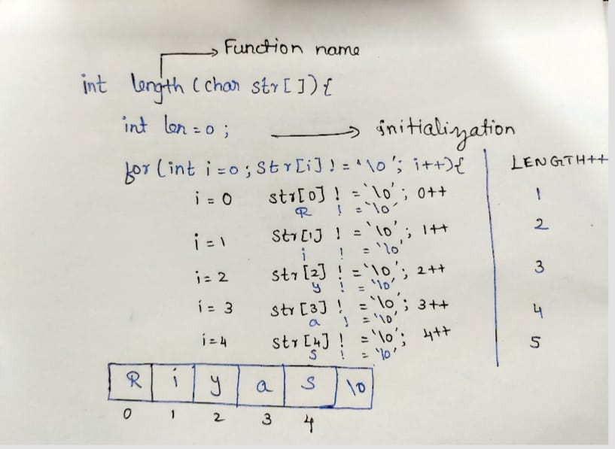
Program:
#include <stdio.h> int length(char str[]){ int len=0; for(int i=0;str[i]!=‘\0’;i++){ len++; } return len; }

Slide 5
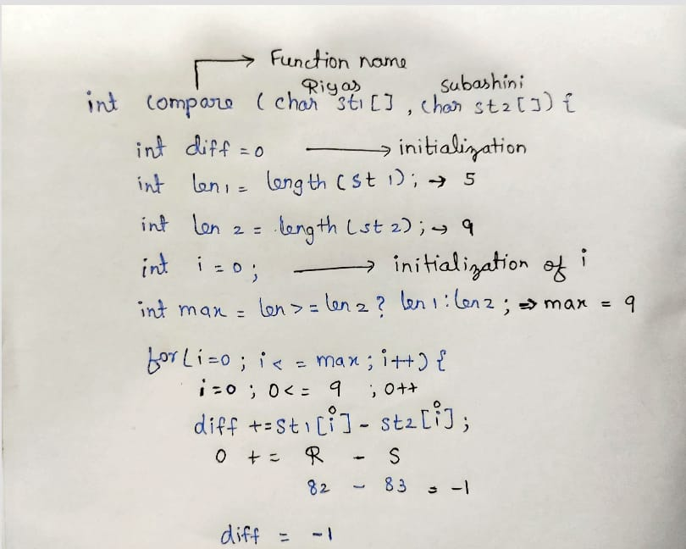
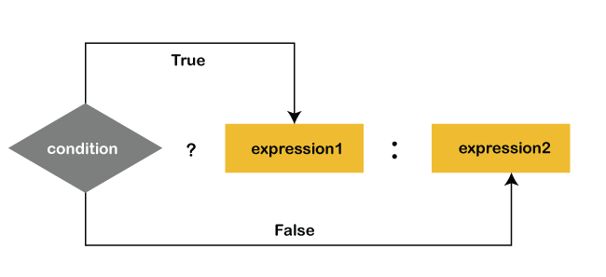
int compare(char st1[],char st2[]){ int diff=0; int len1 = length(st1); int len2 = length(st2); int i=0; int max=len1>=len2?len1:len2; for(i=0;i<=max;i++){ diff+=st1[i]-st2[i]; } return diff;
}

Slide 6
int main() { char st[5][100],g[100]; int a; printf(“enter the words:”); int max=1; for(int i=0;i<5;i++){ scanf(“%s”,st[i]); if(length(st[i])>max){ max=length(st[i]); a=i; } } printf(“enter your guess: \n”); scanf(“%s”,g); if(max%2!=0&&compare(st[a],g)==0){ printf(“you win!”); } else{ printf(“you lose!”); } return 0; }

Slide 7

OUTPUT:
Enter the words:
Riyas
Anugraha
Subashini
Mugesh
Silambarasan
Enter your guess:
Silambarasan
You lose!
OUTPUT:
Enter the words:
Riyas
Anugraha
Subashini
Mugesh
Silambarasan
Enter the guess:
Subashini
You win!

Slide 8

THANK YOU!!!

